Slide 1
Employee Salary prediction using linear regression
Presented by
Name - Chandramani kumari
College name – k.k. college of engineering & management
Department – computer science & Engineering

Slide 2
outline
Problem Statement (should not include solution)
System Development approach (Technology Used)
Algorithm & Deployment( Step by Step Procedure)
Result
Conclusion
References

Slide 3
Problem statement
The primary reason employee switch companies nowadays is often due to the salary offered.
Employee frequently switch companies to secure the expected salary, resulting in a loss for the company.
To overcome this , we came up with an idea: what if the employee receives the desired or expected salary from the company or organization.
In this competitive world, everyone has higher expectations and goals. However, we cannot randomly provide everyone with their expected salary.
There should be a system that measure the employee’s ability to earn the expected salary.
We cannot decide the exact salary, but we can predict it by using specific data set.
A prediction is an assumption about a future event.

Slide 4
System approach
System Requirement
Processor : Intel ® Core ™ i3
Processor speed : 3.06 GHz
RAM : 8GB
Hard Disk : 1TB
Keyboard : Standard 104 enhanced keyboard

Slide 5
Library Requirement
Seaborn:- seaborn is an amazing visualization library for statistical graphics plotting in python. It provides beautiful default styles and color palettes to make statistical plots more attractive.
Pandas :- pandas are software library written for the Python programming language for data manipulation and analysis. In particular, it offers data structures and operations for manipulating numerical tables and time series. It is well suited for working with tabular data such as spreadsheets , SQL tables.

Slide 6
Library Requirement
Matplotlib :- It is a comprehensive library for creating static, animated, and interactive visualizations in Python.
NumPy :- NumPy is a general-purpose array-processing package. It provides a high-performance multidimensional array object, and tools for working with these arrays. It is open-source software and the fundamental package for scientific computing with Python.
Scikit learn :- it is a supervised and unsupervised learning algorithms . Scikit- learn can also be used for data-mining and data analysis

Slide 7
Library Requirement
Preprocessing :- in data science transforming raw data into a clean structured format for analysis. It involves tasks like handing missing values, normalizing data and encoding variables.
Streamlit :- Streamlit is a free and open-source framework to rapidly build and share beautiful machine learning and data science web apps. It is a Python-based library specifically designed for machine learning engineers.
Data scientists or machine learning engineers are not web developers and they're not interested in spending weeks learning to use these frameworks to build web apps.

Slide 8
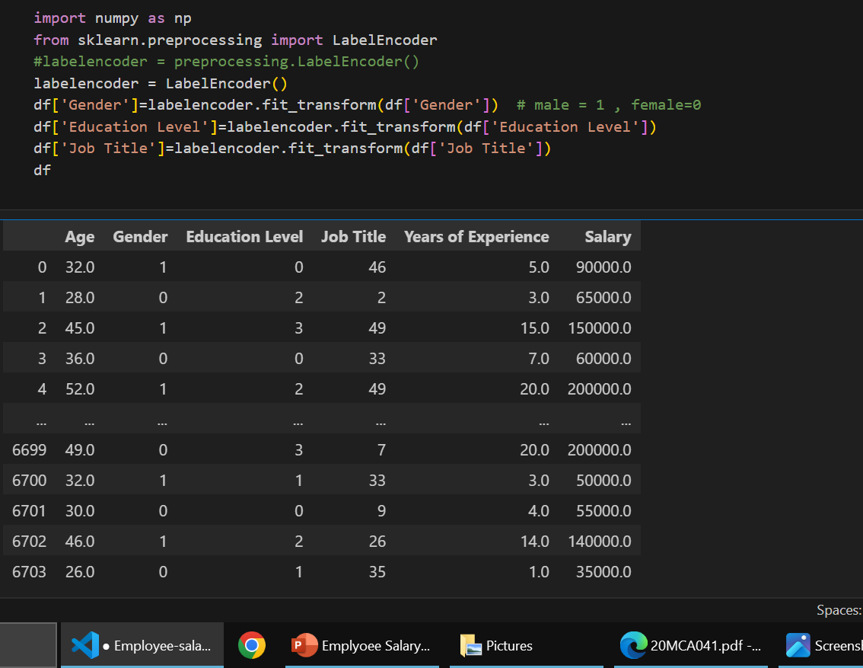
Algorithm & deployment
MODEL TESTING :- Prior to building a linear model, we need to prepare a training set and a test set (part of standard procedure in a machine learning workflow). The training set will be used to train the model whereas the test set will be used to assess the performance of the trained model in predicting the result from unseen data.
LabelEncoder:- LabelEncoder in python is a class from the sklearn.preprocessing module of the scikit-learn library, used for converting categorical labels into numerical format.

Slide 9
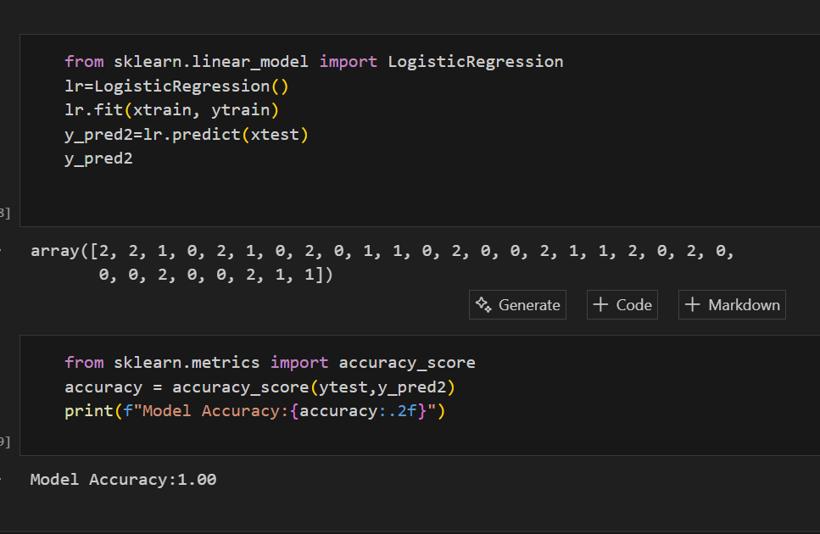
Algorithm & deployment
LogisticRegression :-LogisticRegression is a supervised machine learning algorithm used for classification problems. It is used for binary classification where the output can be one of two possible categories such as yes/no, true/false or 0/1.

Slide 10
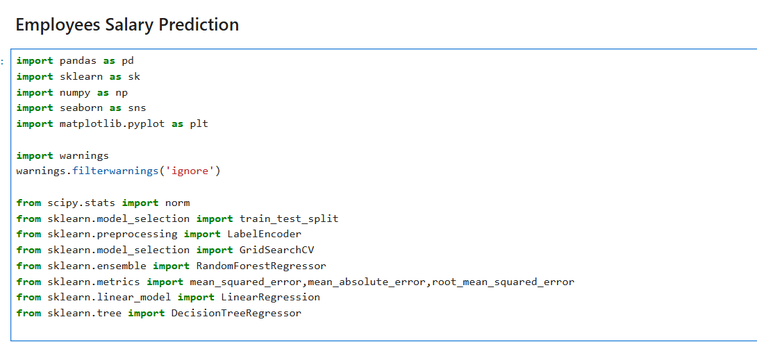
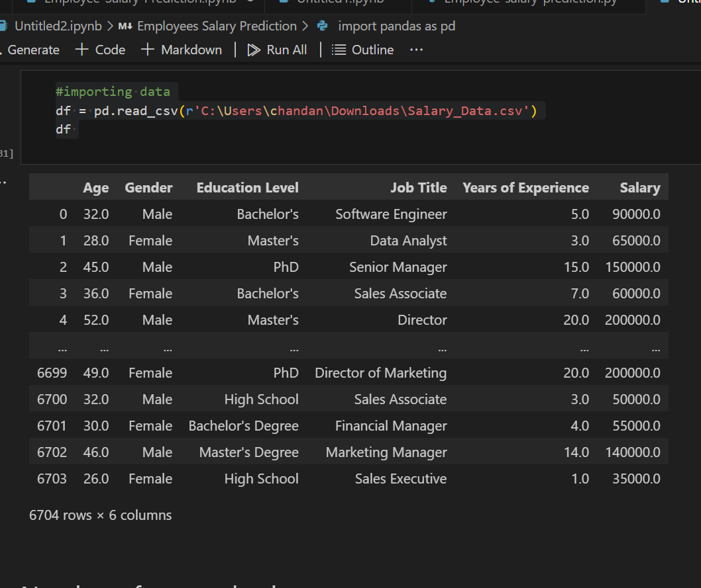
Algorithm & Deployment
Import the required Libraries
Initialise and print the Dataset

Slide 11
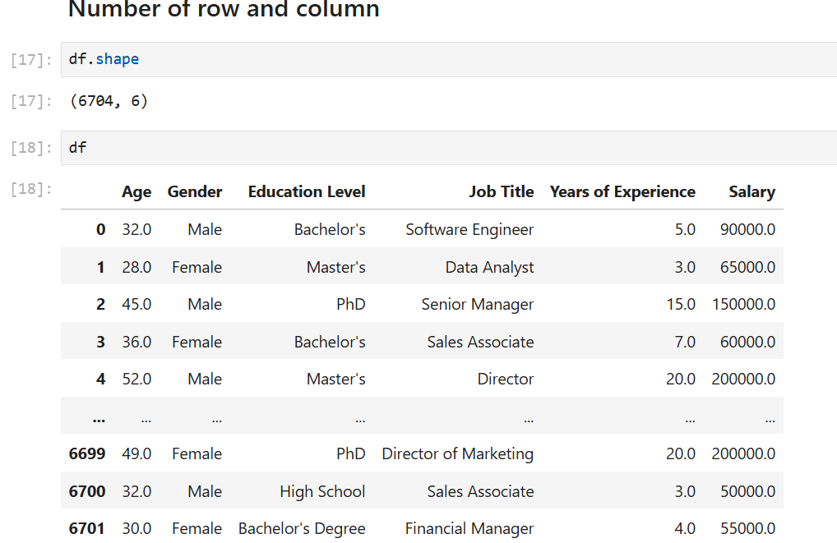
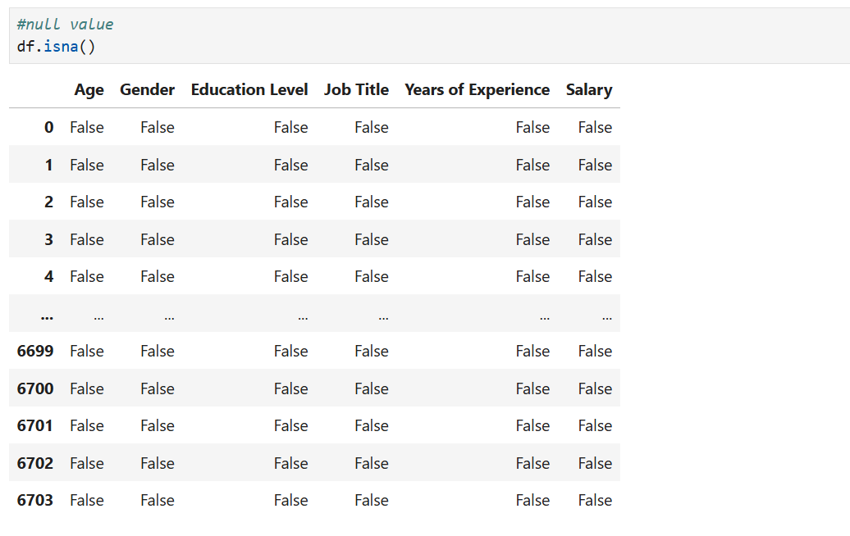
Algorithm & deployment
Check null values
Select all the row and column 1 from the dataset to “x”

Slide 12
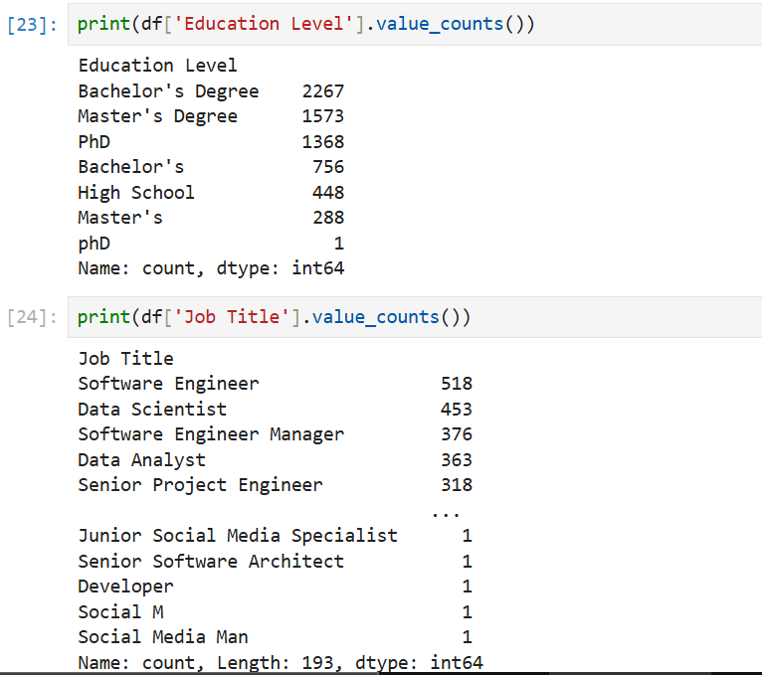
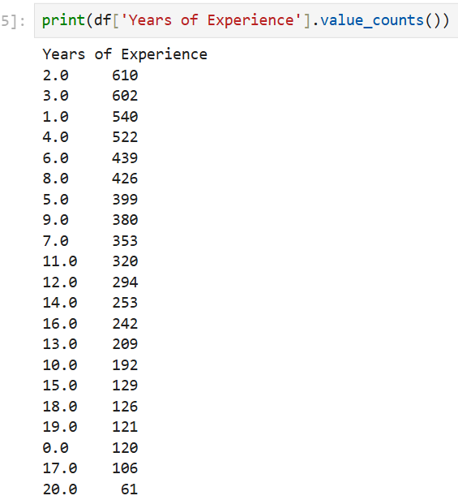
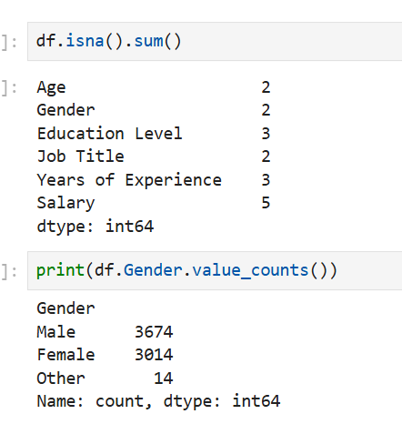
Algorithm & deployment
Print education values and job title values
Count year of experience
Sum of null values

Slide 13
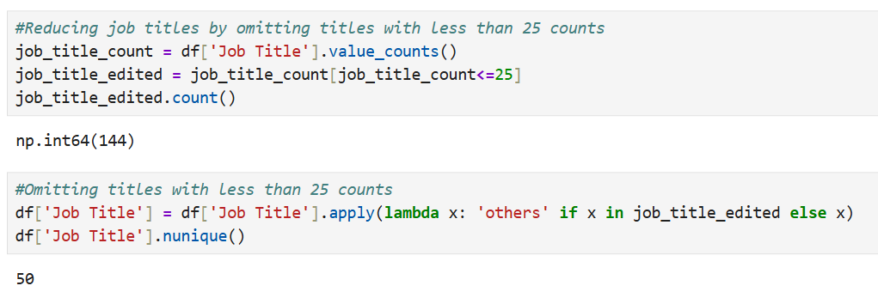
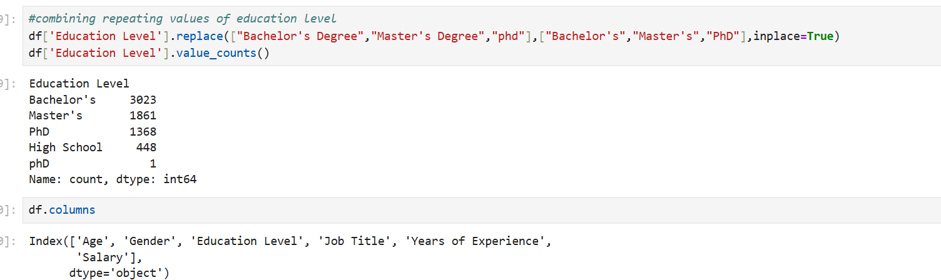
Reducing job title is less than 25 counts
Combining repeated values

Slide 14
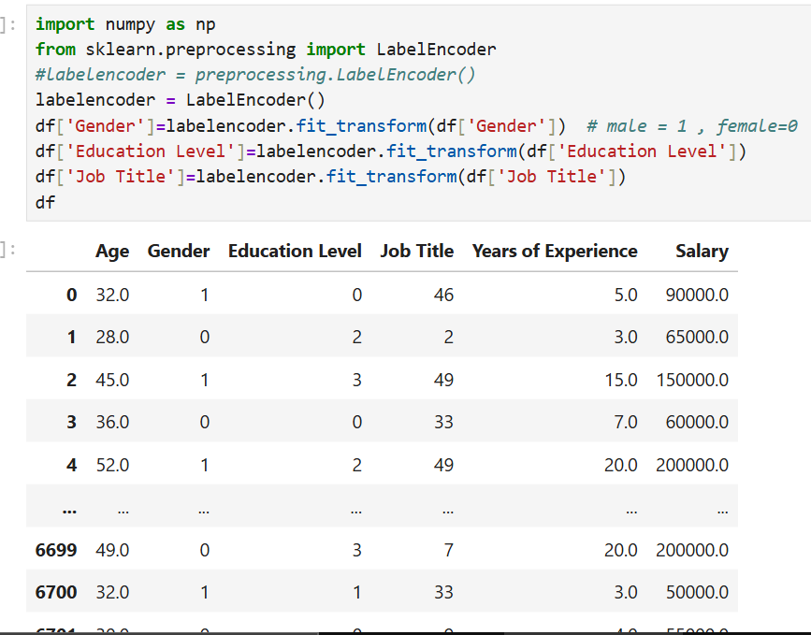
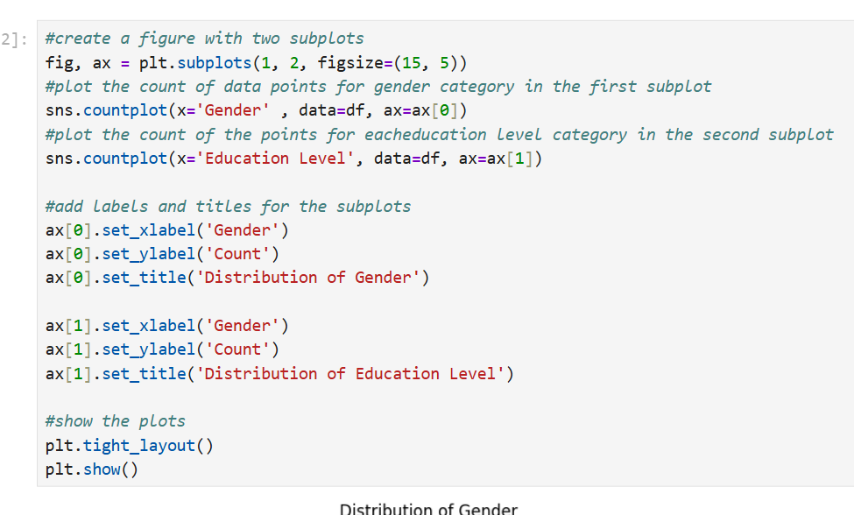
To convert categorical to numeric values
Plot graph

Slide 15
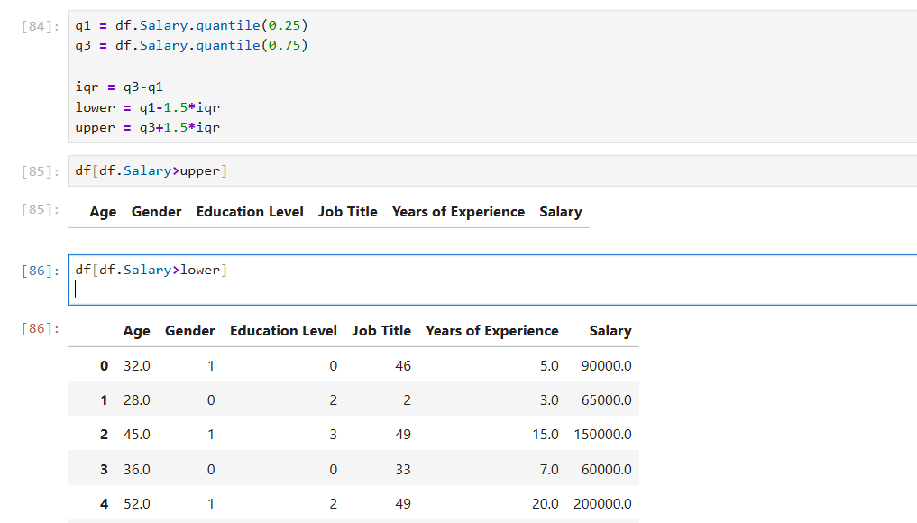
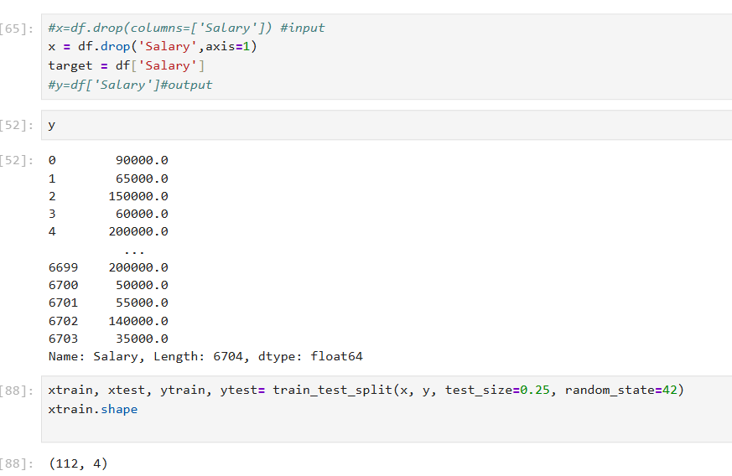
Predict Salary
Drop Salary

Slide 16
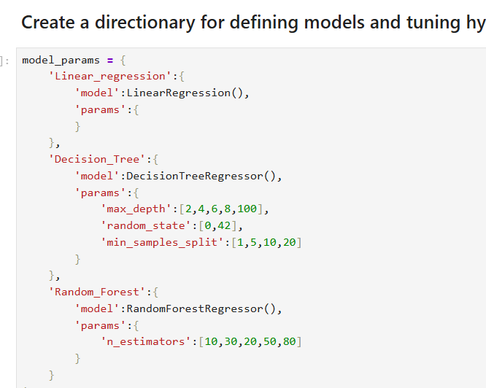
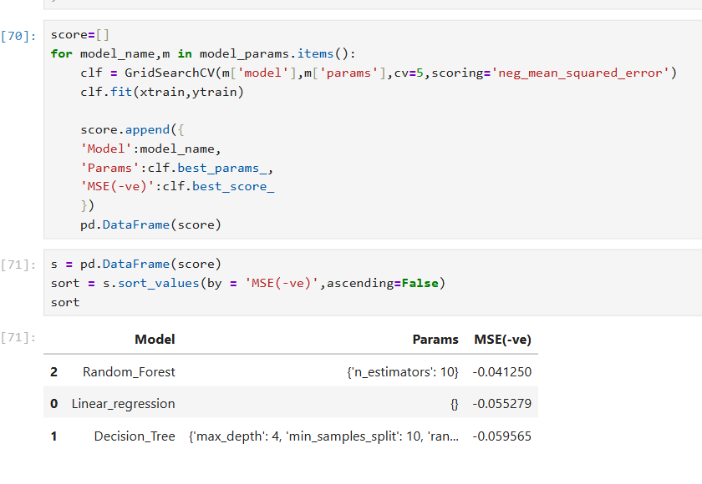
Create Models
Order of Best Model

Slide 17
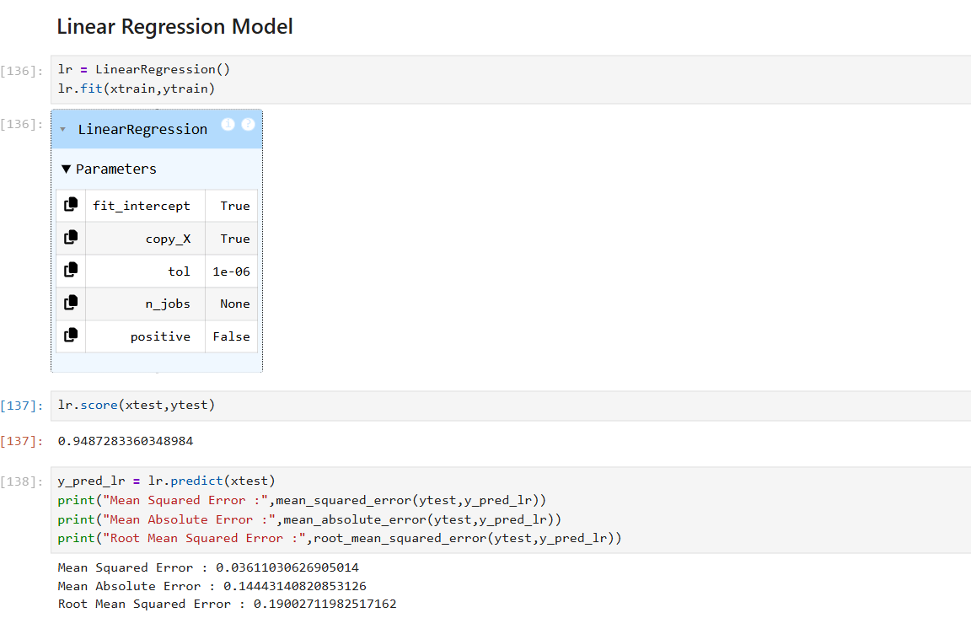
Linear Regression Model

Slide 18
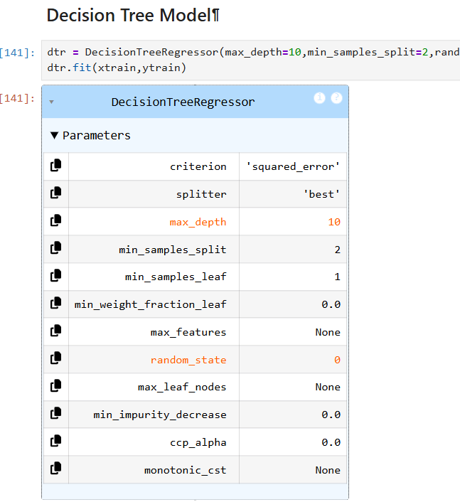
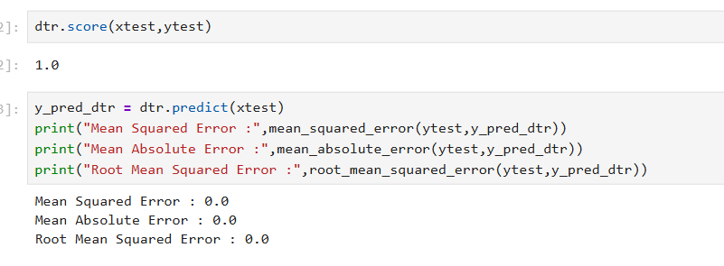
Decision Tree Model

Slide 19
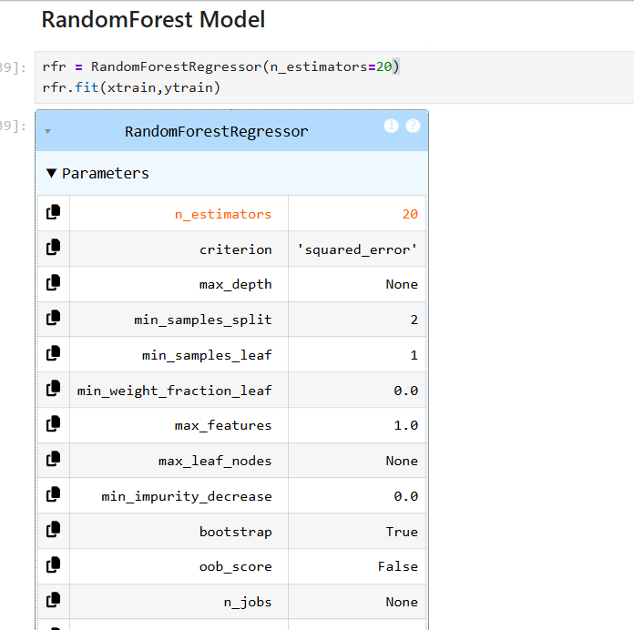
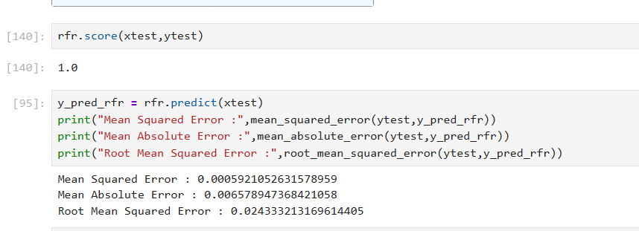
Random forest model

Slide 20
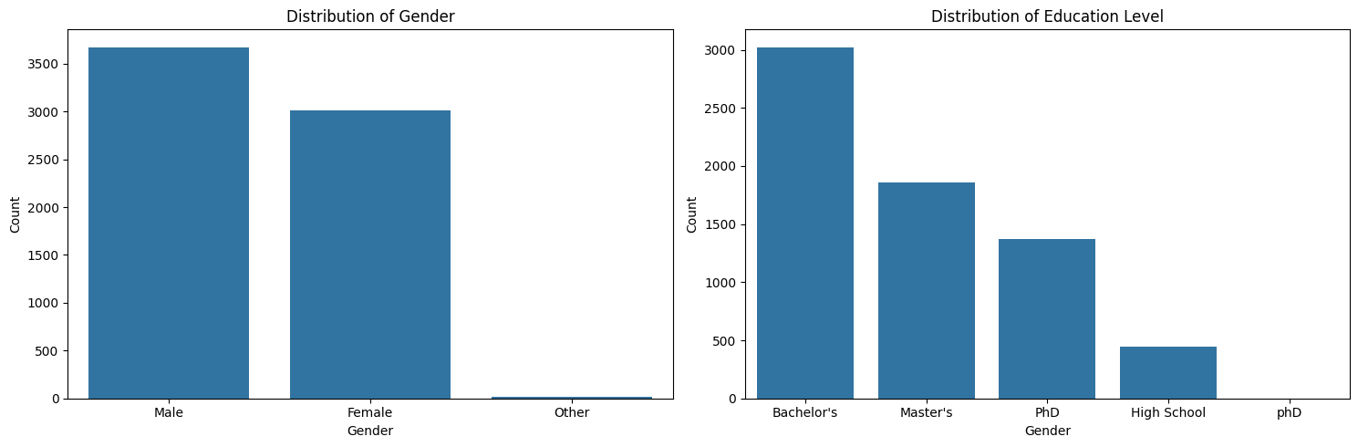
result

Slide 21
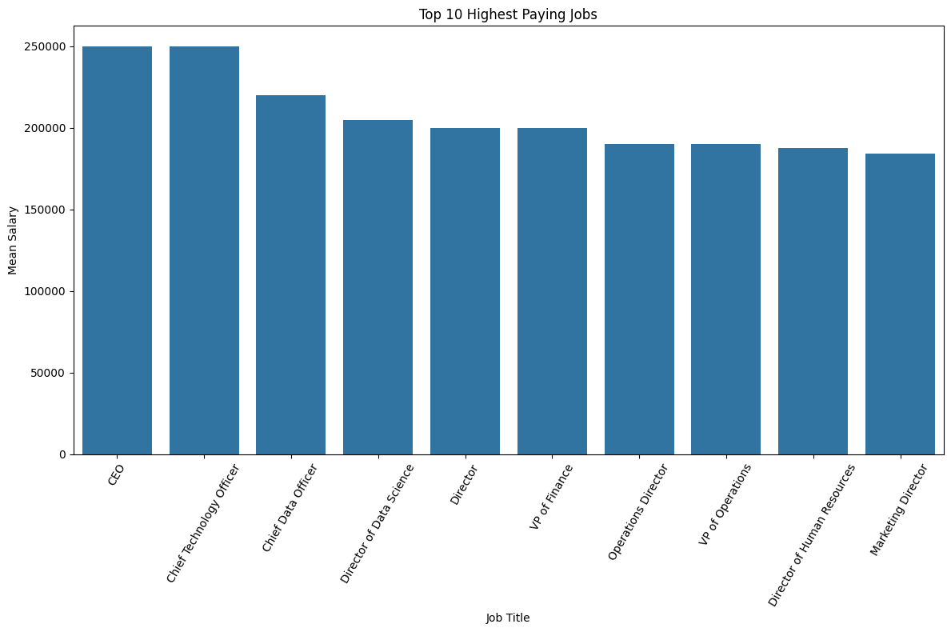
result

Slide 22
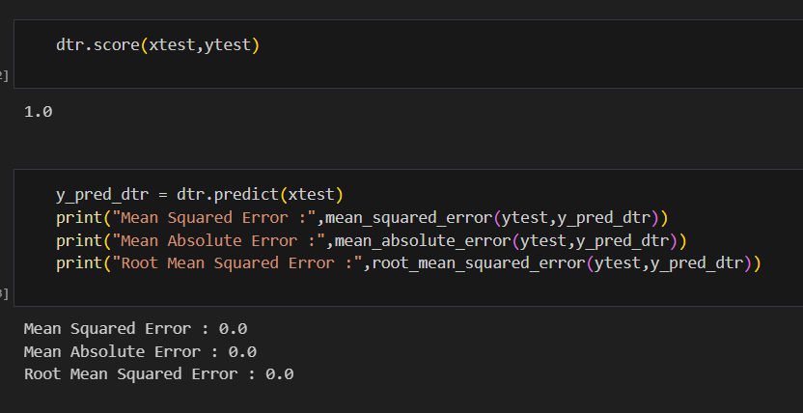
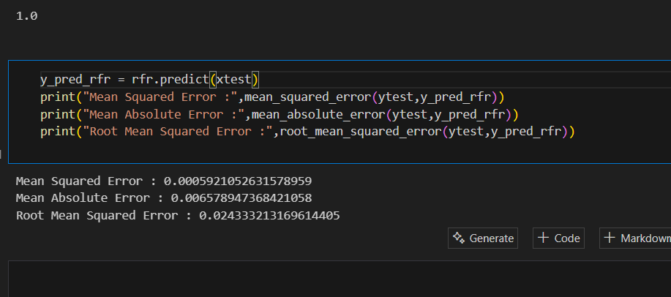
result
Decision Tree Model
Random Forest Model

Slide 23
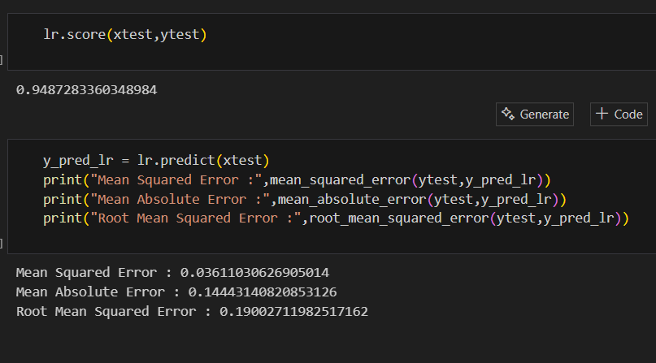
Linear Regression Model

Slide 24
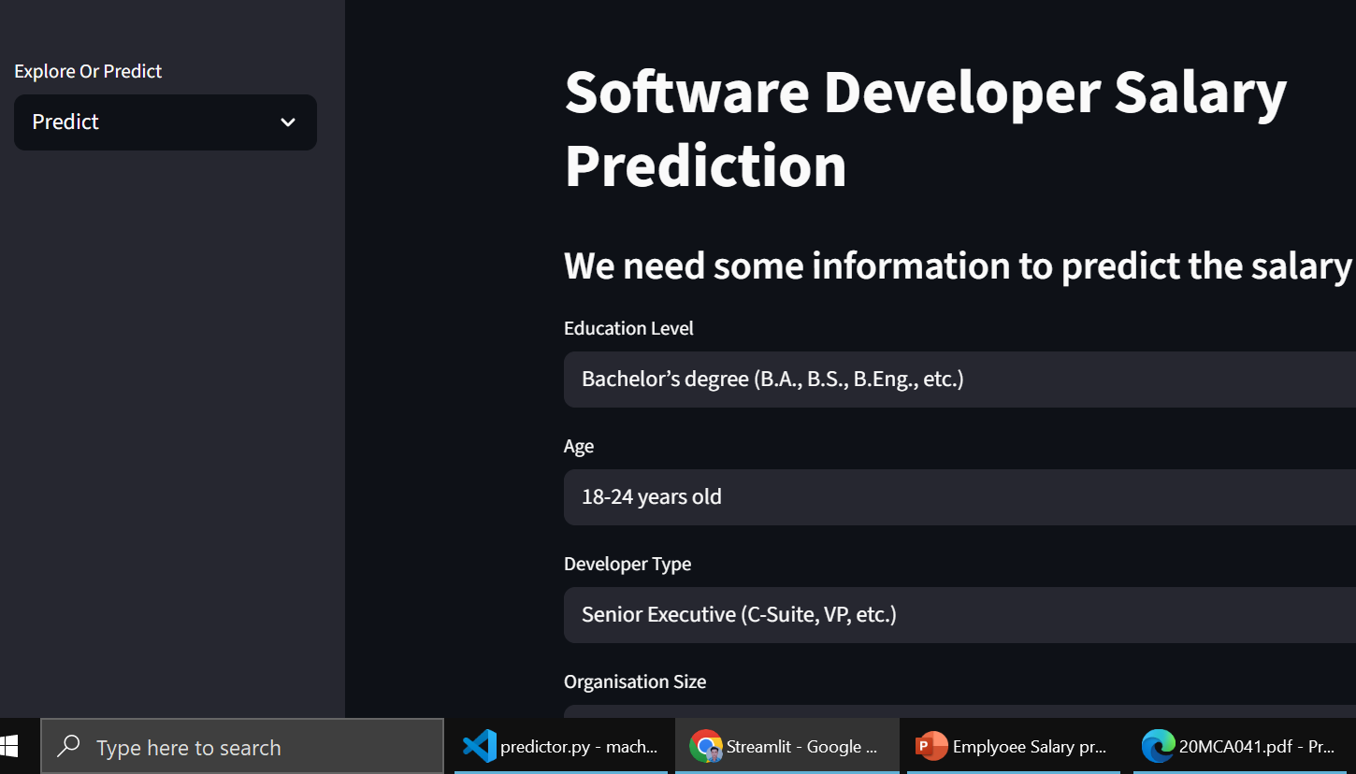

Slide 25
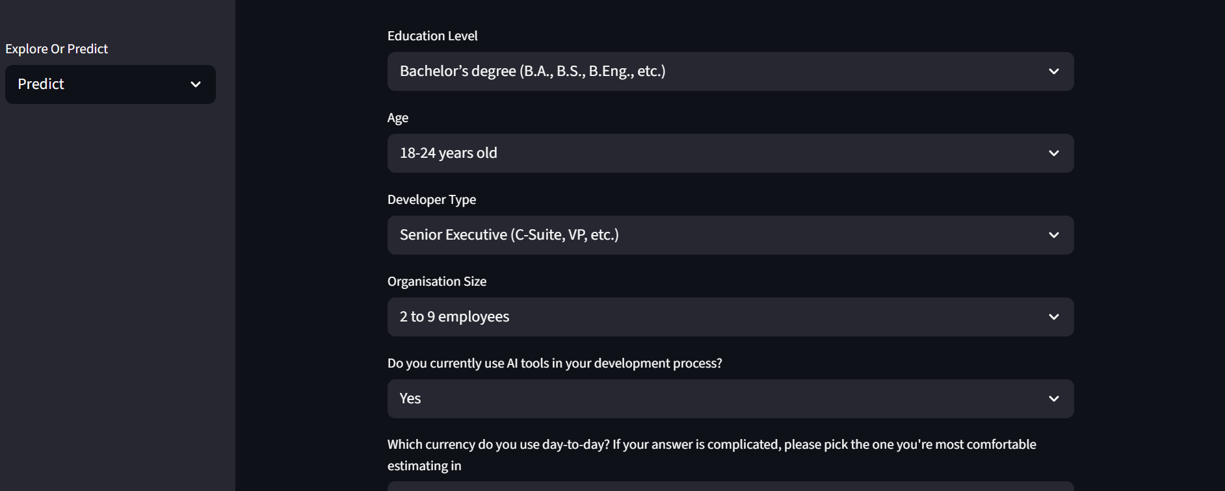

Slide 26
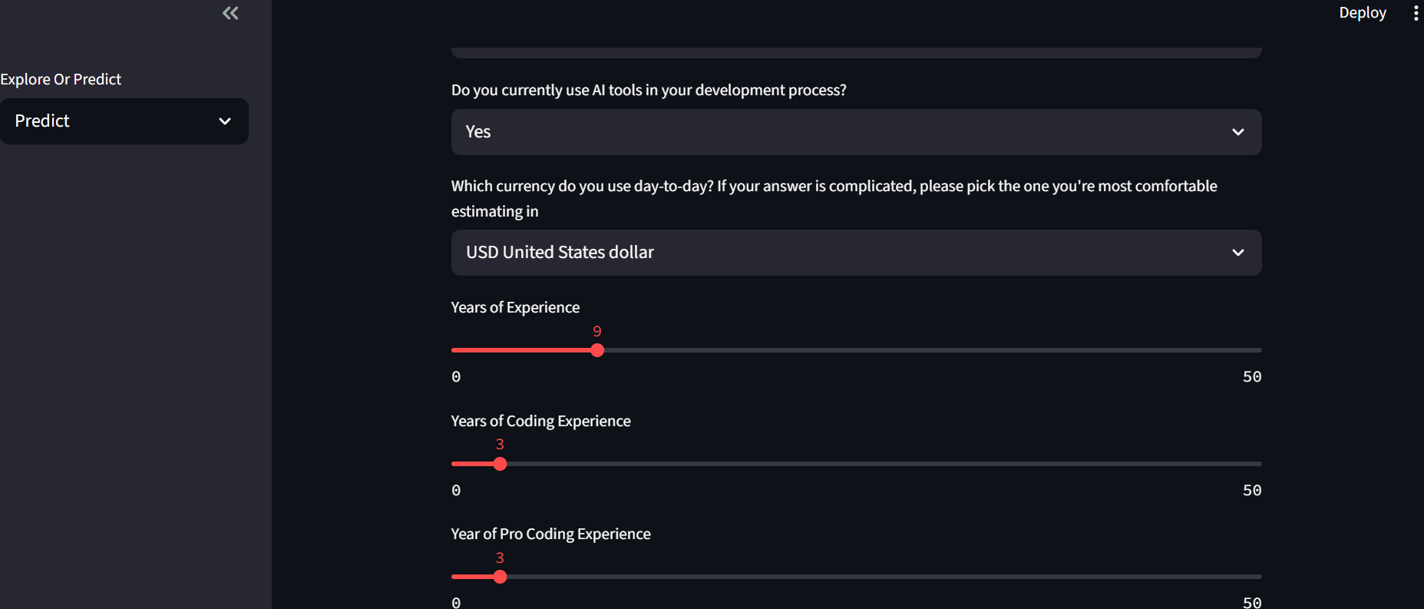

Slide 27
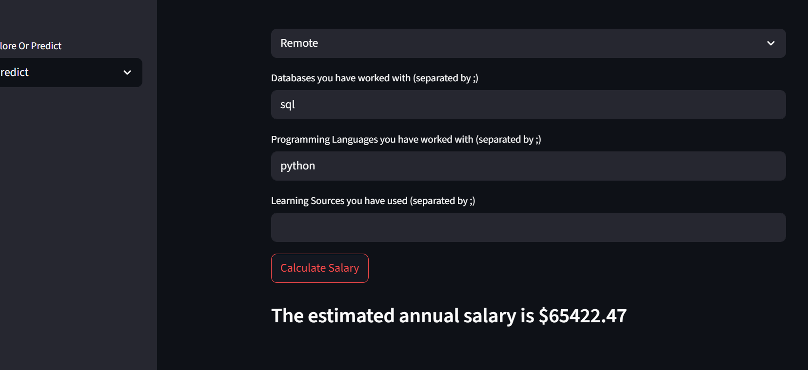
GITHUB LINK
https://github.com/chandramani21/Employee_salary_prediction.git

Slide 29
Conclusion
In this paper, we carried out a study between linear Regression and Random Forest . We discussed Which technique is more efficient compared to the other and found out that linear Regression is more efficient ,has lower error and has higher accuracy But as we tested on the same dataset, the conclusion is partial. After testing with another dataset, we can model gives flawless salary values and will proceed with that.
The Random Forest model achieved the highest R-squared score (1.0) and the lowest MSE, MAE, and RMSE values, indicating the best predictive performance among the three models.
2. The Decision Tree model performed well with an R-squared score of (1.0) but had higher errors compared to the Random Forest.
3. The Linear Regression model had the lowest R-squared score (0.948) and the highest errors, suggesting it may not capture the underlying patterns in the data as effectively as the ensemble models.
In conclusion, the Random Forest model appears to be the most suitable for predicting salaries in this dataset, as it offers the highest predictive accuracy and the lowest error metrics. Further optimization and fine-tuning of the Random Forest model could potentially lead to even better results.
.

Slide 30
Future scope
In future work, we aim to deploy it on Heroku and generate a URL that allows anyone with access to use our model. And try to save and reuse the trained model. We also aim to increase accuracy by training the model with more data records

Slide 31
References
Raziq, A., Maulabakhsh, R. 2015. Impact of Working Environment on Job Satisfaction. Procedia Economics and Finance, 23, 717-725, DOI: 10.1016/S2212-5671(15)00524-9.
Brenninger, H-J., 2015. Employee satisfaction and its impact on company value, Doctoral thesis. University Of Latvia, Faculty of Economics and Management, Riga Latvia.
Bin Shmailan, A.S., 2016. The relationship between job satisfaction, job performanceand employee engagement: An explorative study, Issues in Business Management and Economics, 4(1), 1-8, DOI:10.15739/IBME.16.001.
Susmita Ray," A Quick Review of Machine Learning Algorithms," 2019 International Conference on Machine Learning, Big Data, Cloud and Parallel Computing (ComIT-Con), India, 14th -16th Feb 2019.
Yashpandey474/salary-prediction-using-machine-learning
Kaggle
Stackoverflow
Pornthep Khongchai, Pokpong Songmuang, “Improving Students’ Motivation to Study using Salary Prediction System” 2016 13th International Joint Conference on Computer Science and Software Engineering (JCSSE).

Slide 32
Thank you

